Slide 1
«Московский областной медицинский колледж №1»
Презентация по теме «Welcome to the United Kingdom of Great Britain and Northern Ireland»
по дисциплине ОУД.03 Иностранный язык специальность 34.02.01 Сестринское дело
Разработчик:
Гурдяева О.А., преподаватель иностранного языка, первая квалификационная категория, Мытищинский филиал

Slide 2
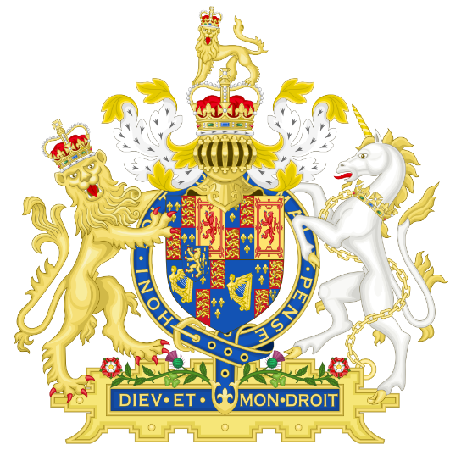
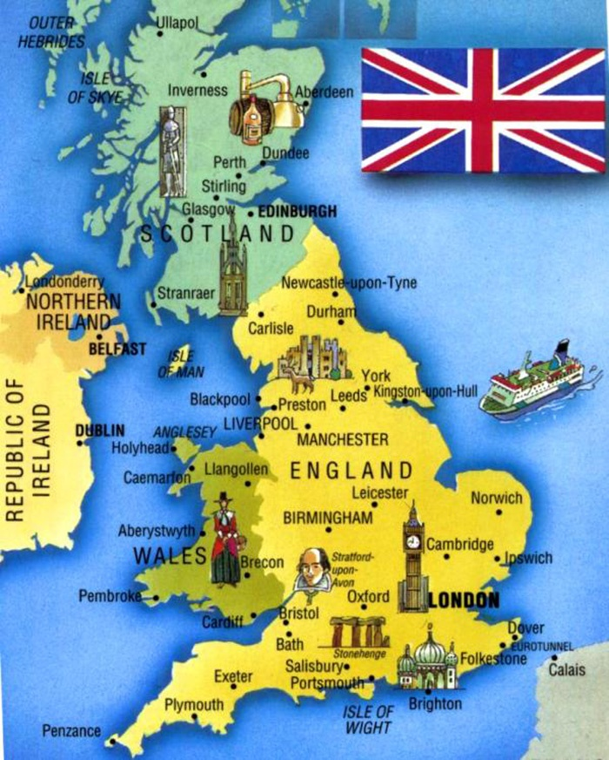
Great Britain
Geographical position
Politics of Great Britain
London
Famous British people

Slide 3
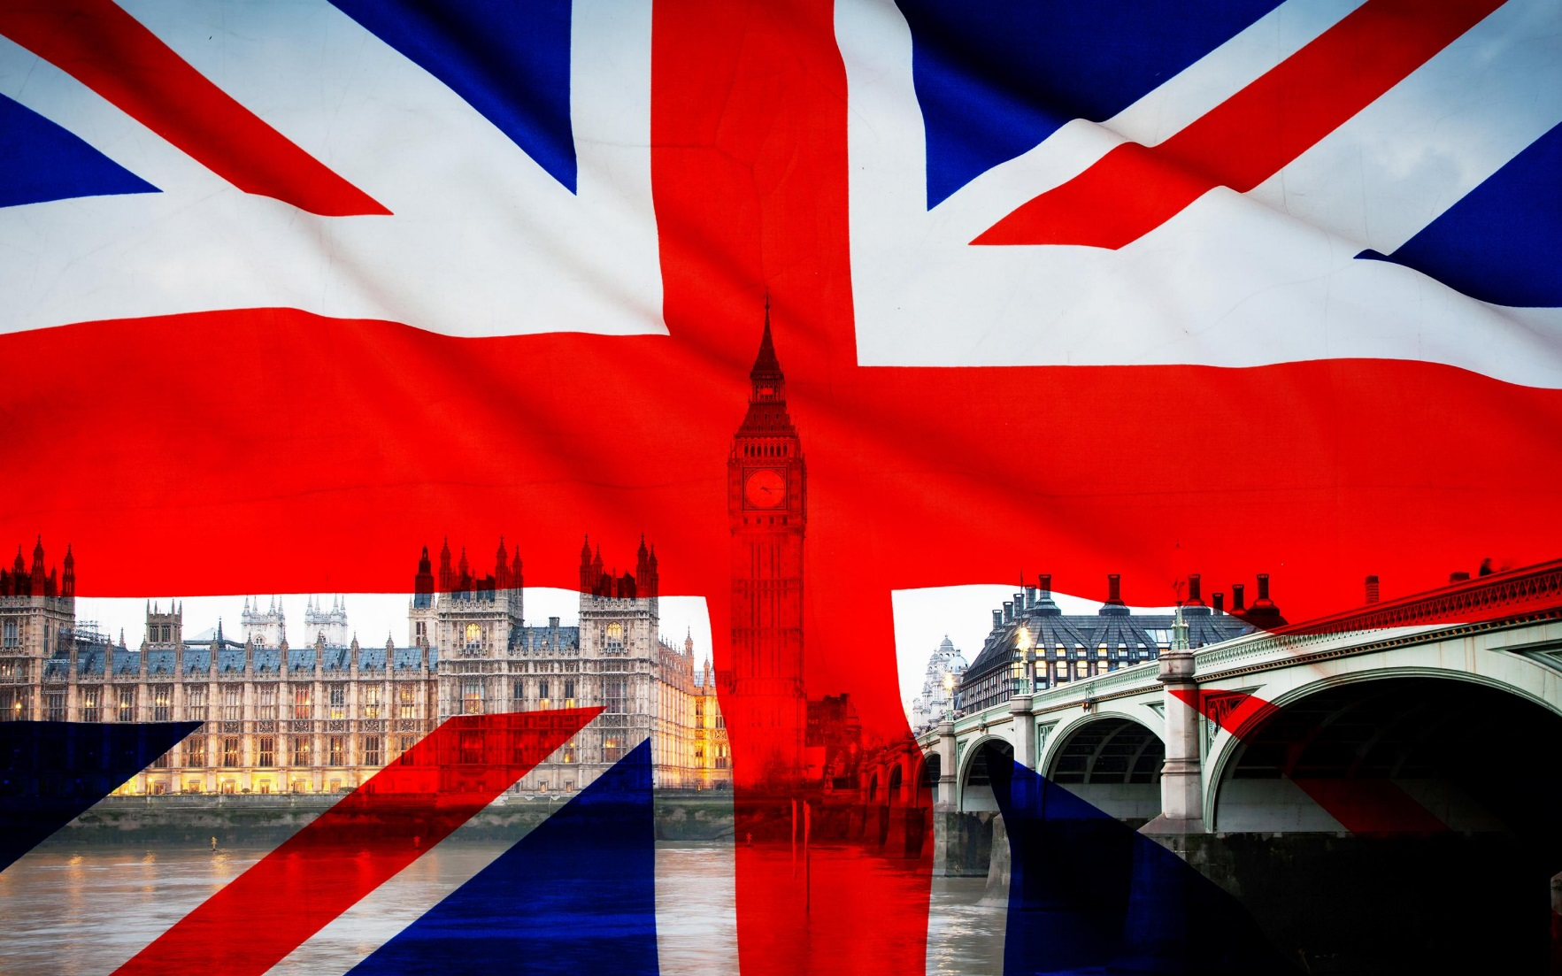
What is the official name of Britain?

Slide 4
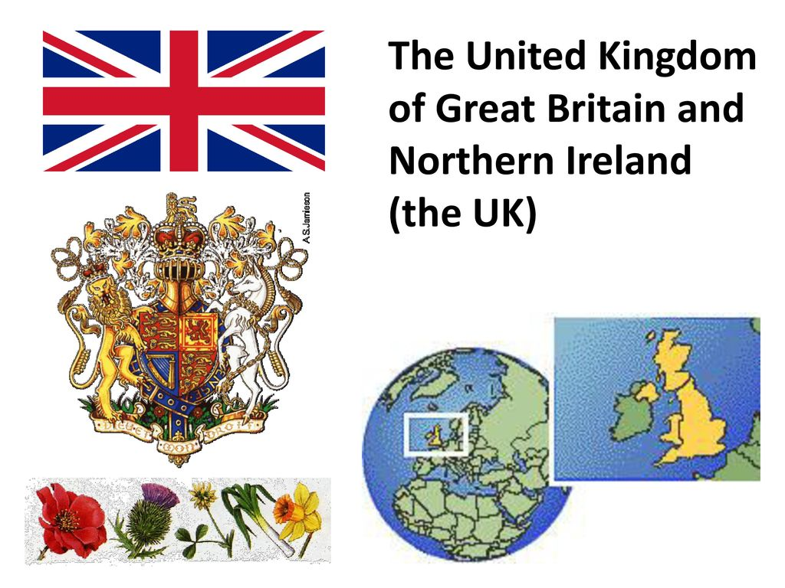
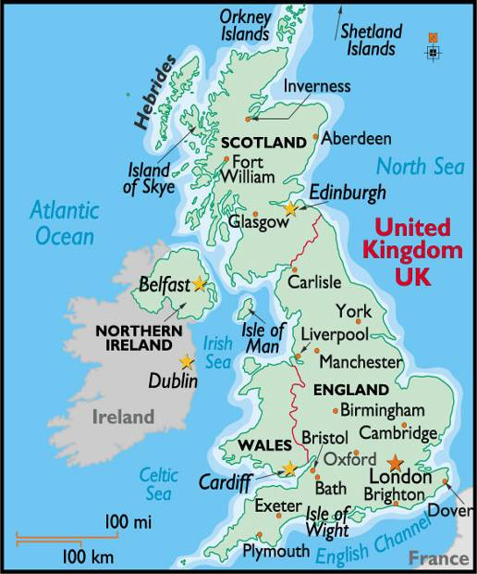
Where is the UK situated on?

Slide 5
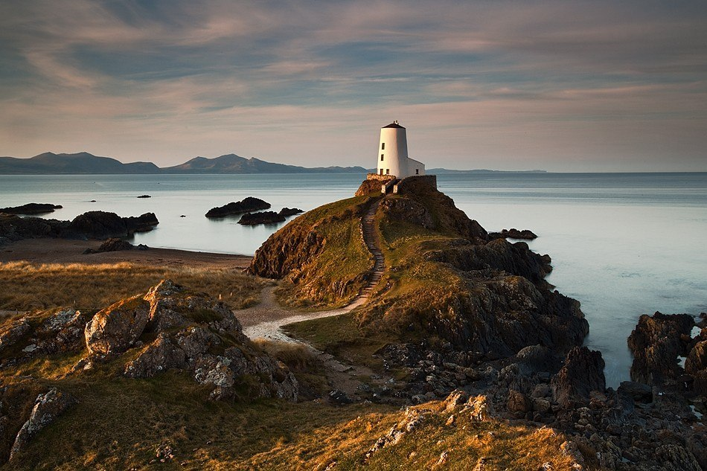
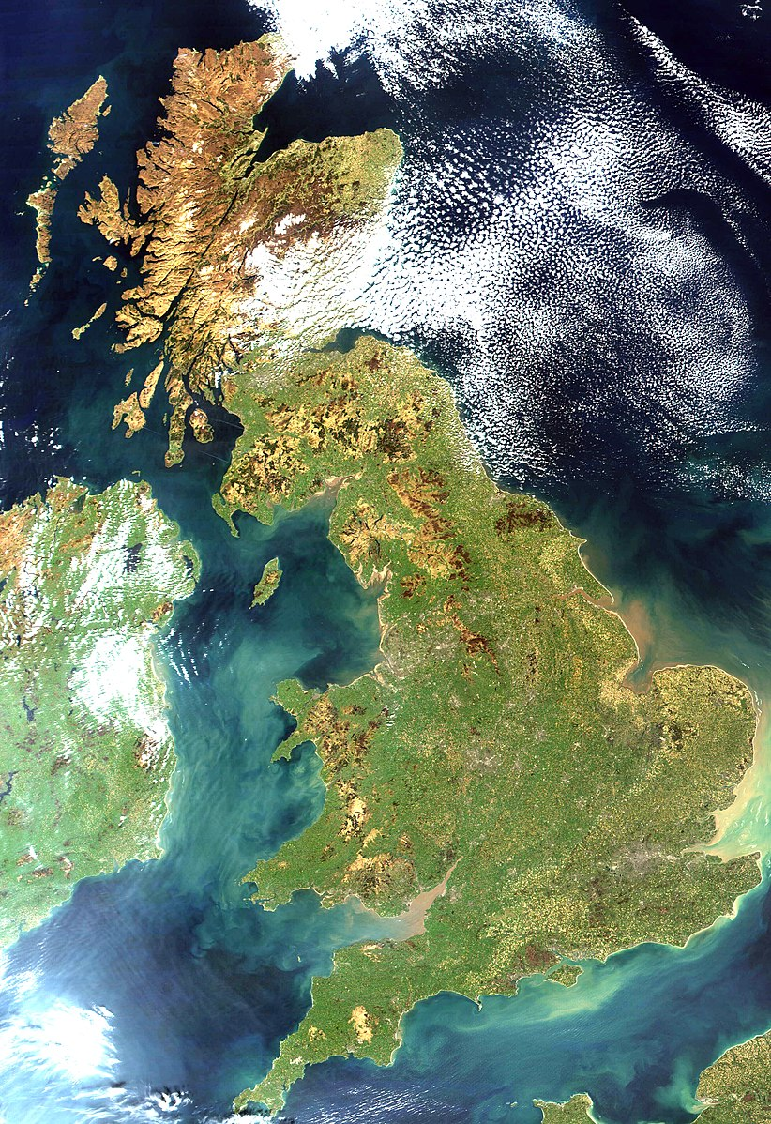
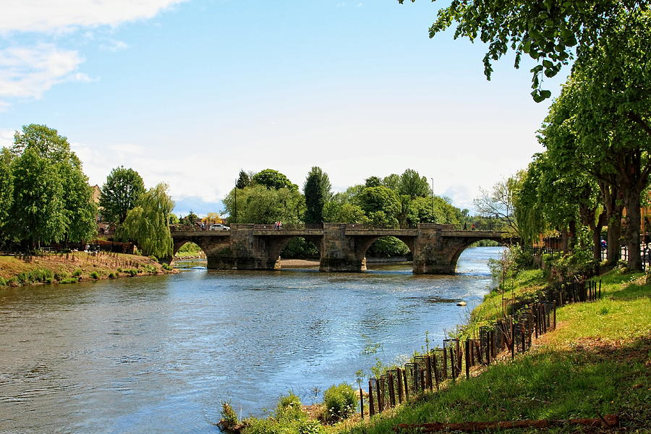
What is the surface of Great Britain?

Slide 6
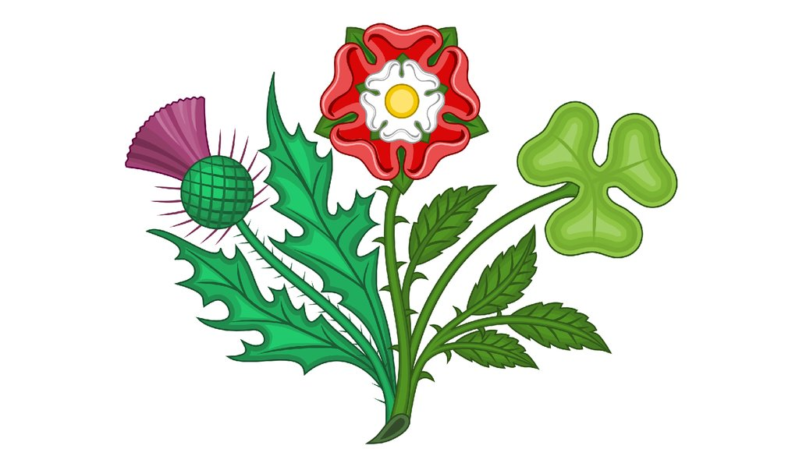
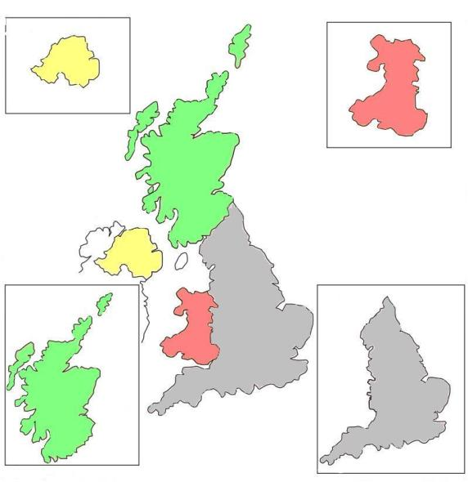
What are the capitals of Scotland, Wales, Northern Ireland?

Slide 7
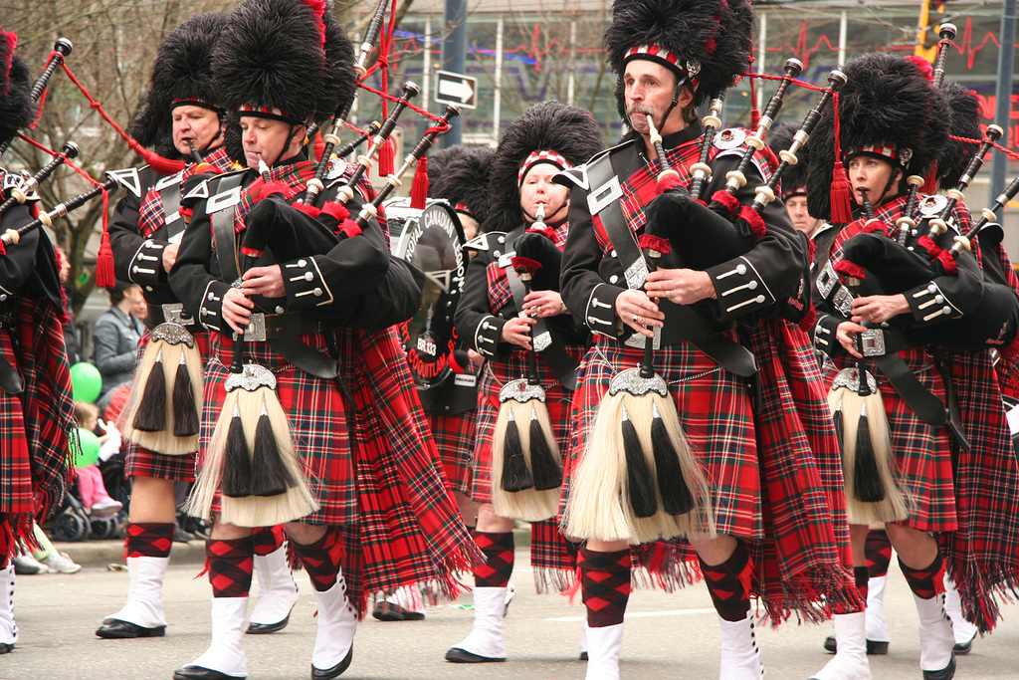
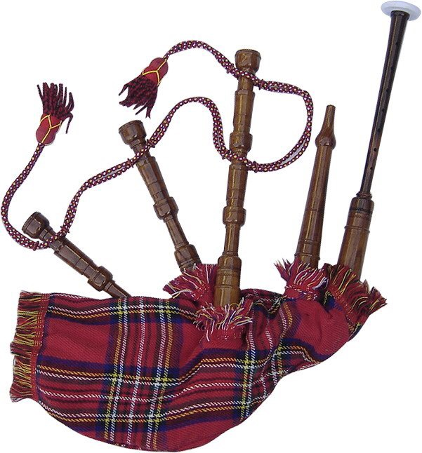
What is the national instrument of Scots?

Slide 8
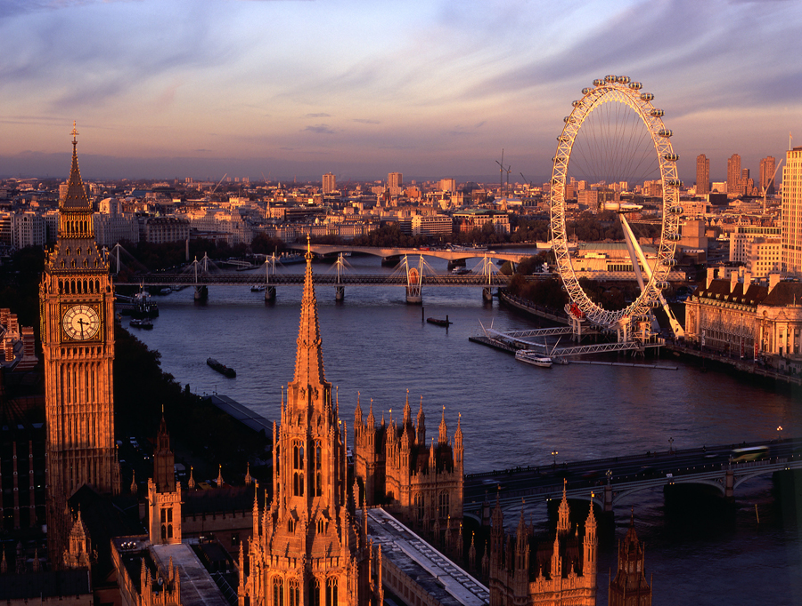
What parts is London divided into?

Slide 9
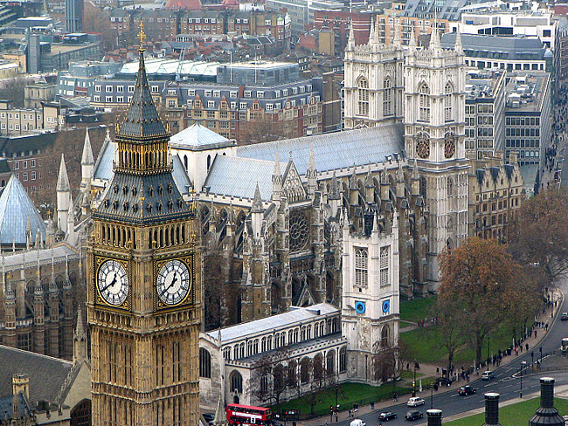
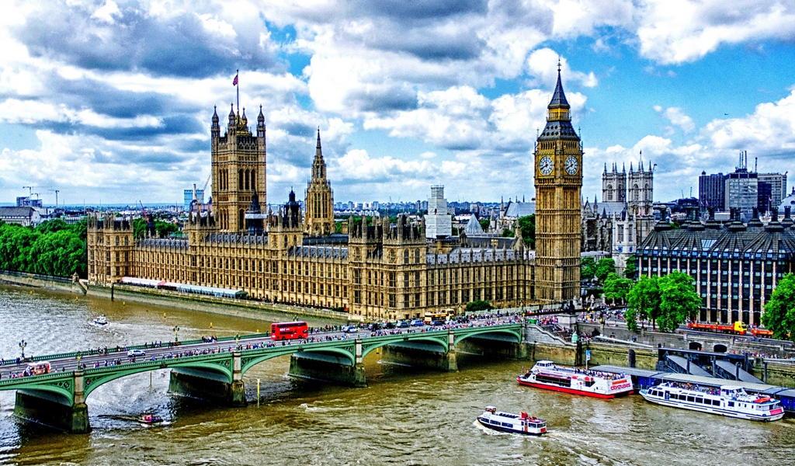
What is the official part of London?

Slide 10
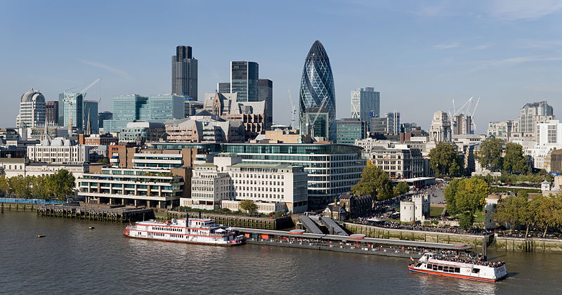
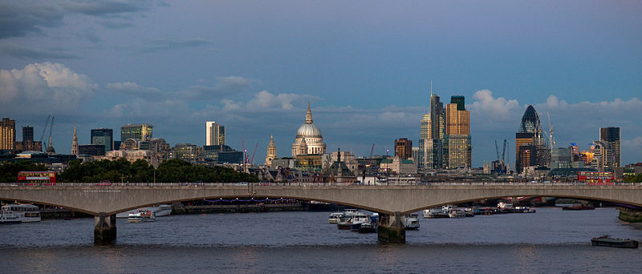
What is the oldest part of London,
its financial and business center?

Slide 11
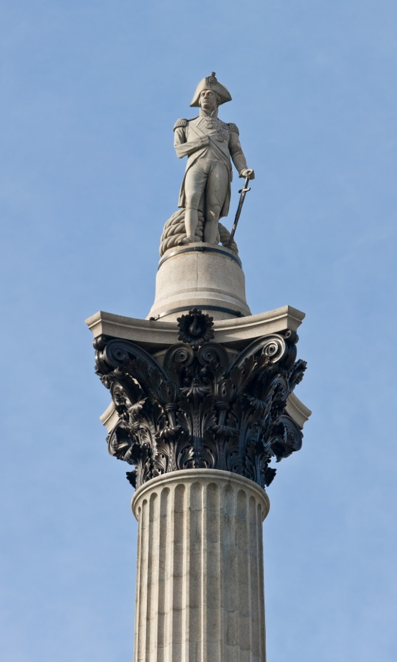
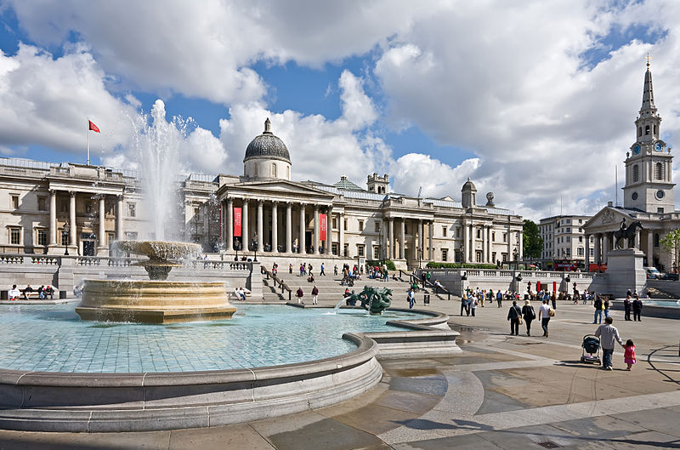
What is the geographical centre of London?

Slide 12
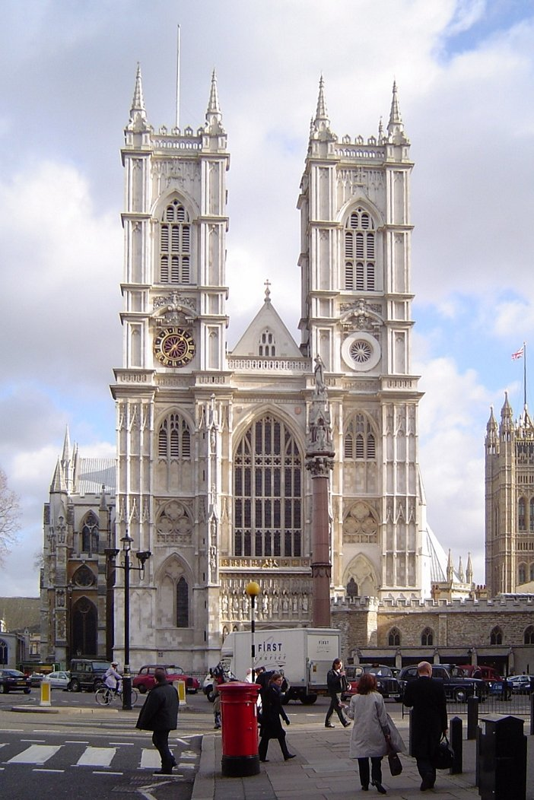
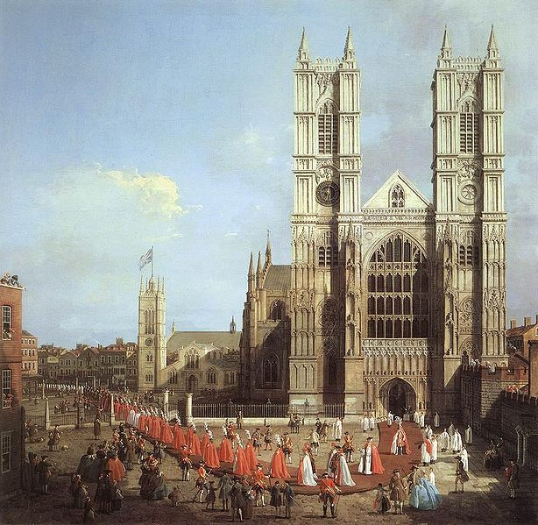
Where is the coronation of nearly all kings and queens has taken place?

Slide 13
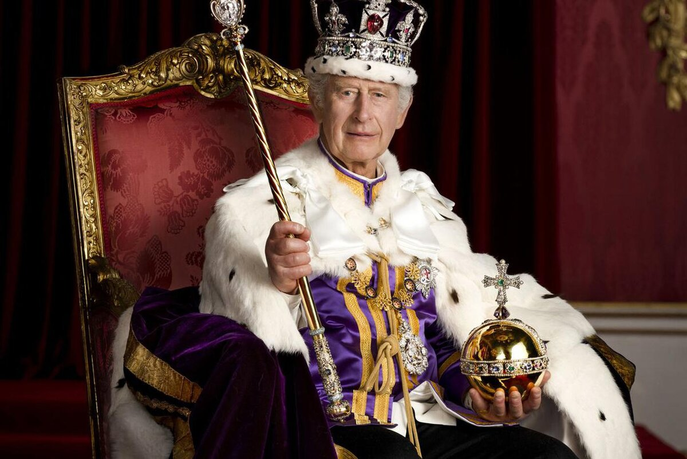
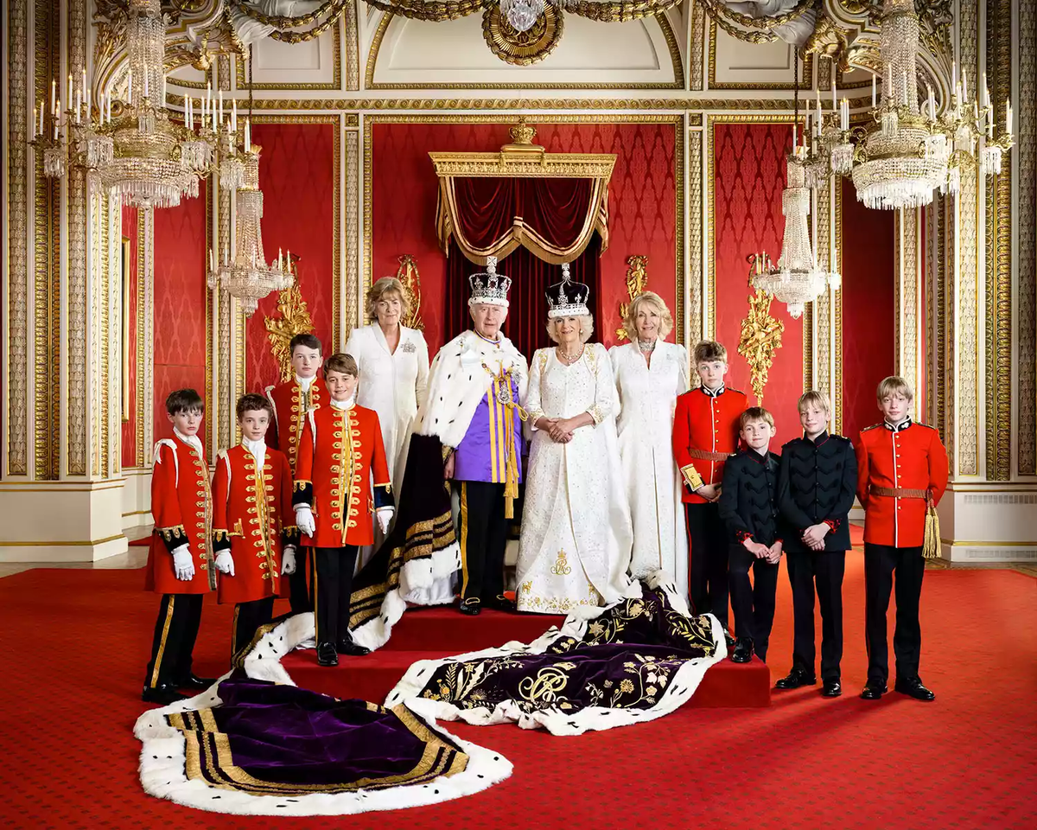
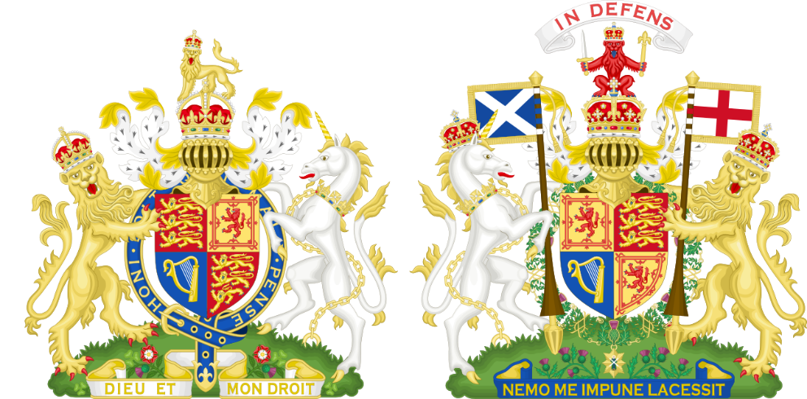
What is the name of the King of the United Kingdom?

Slide 14
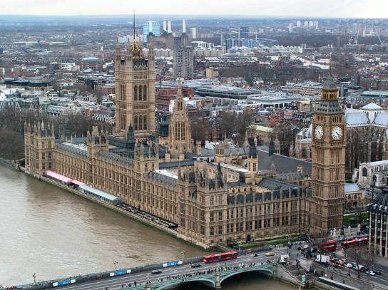
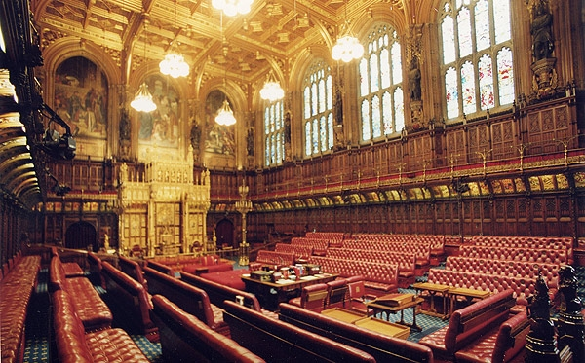
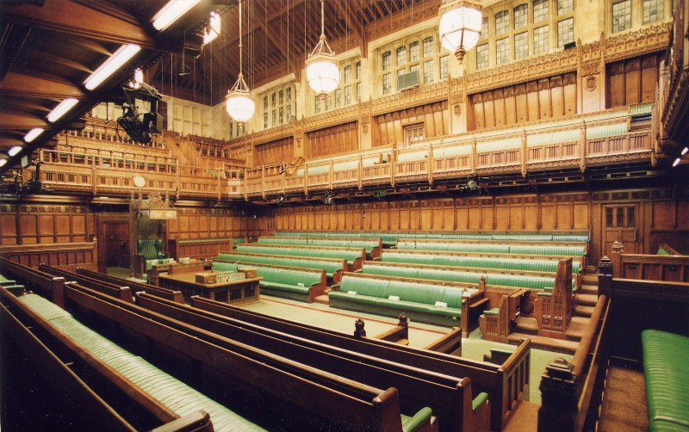
How many chambers does the British Parliament consist of? What are they?

Slide 15
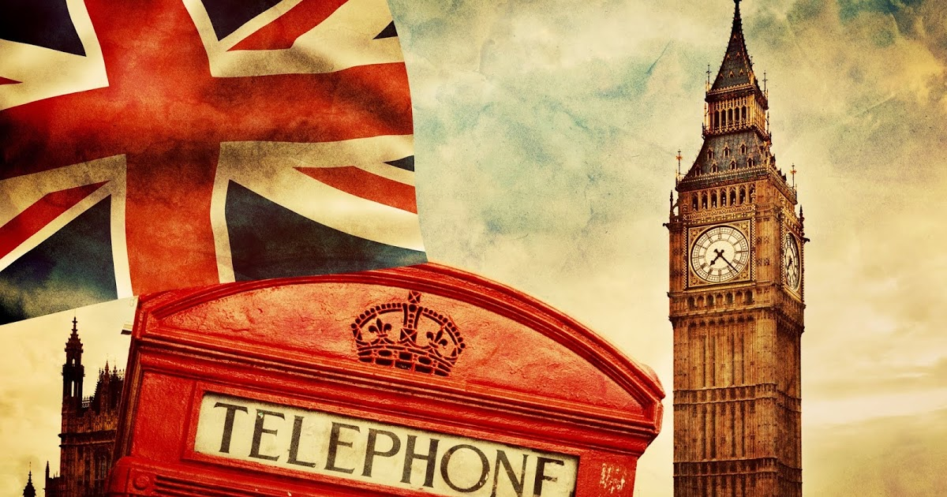
What does the UK use as its national flag?

Slide 16
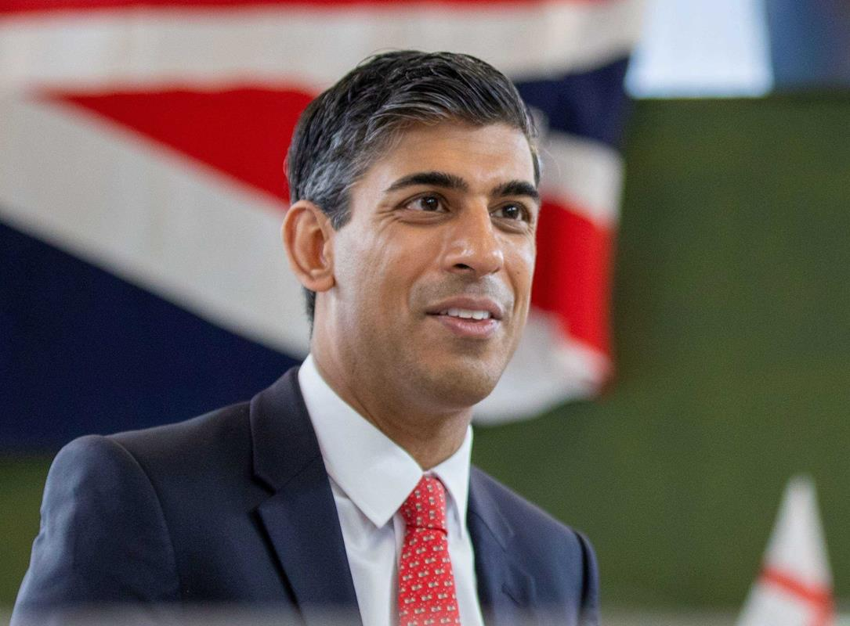
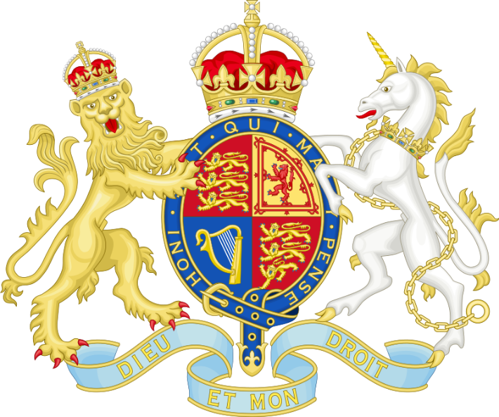
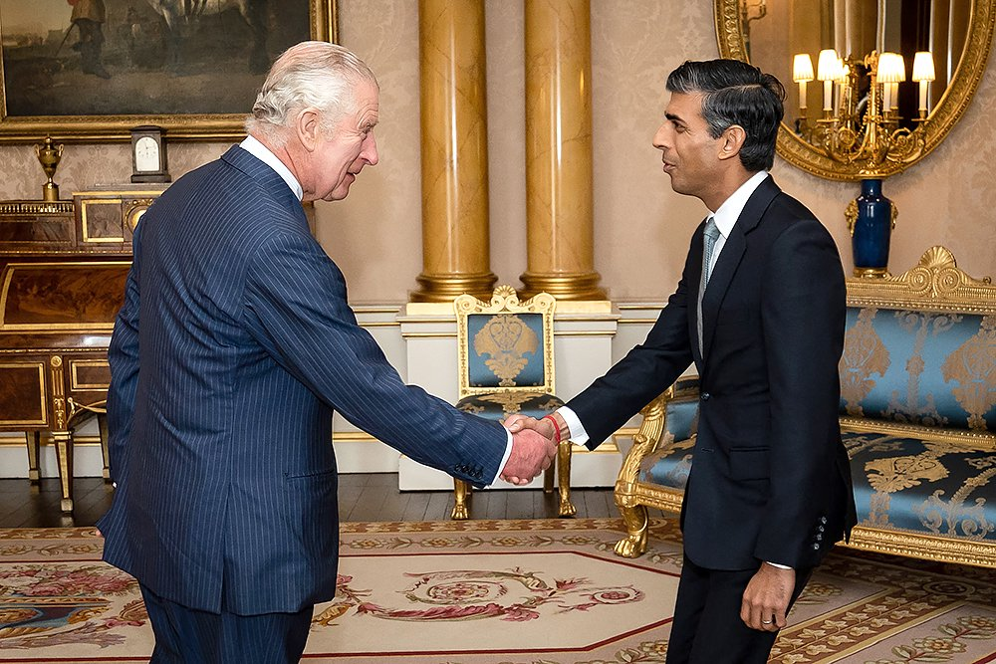
What is the name of the Prime Minister of the UK?

Slide 17
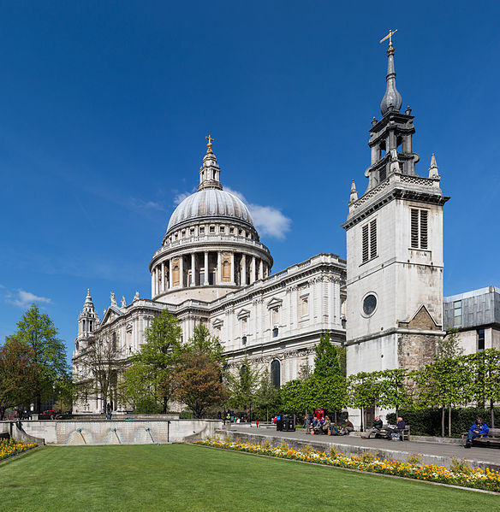
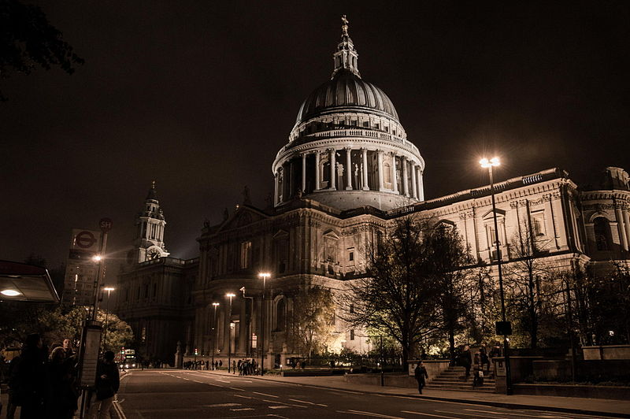
What was built by the architect Christopher Wren?

Slide 18
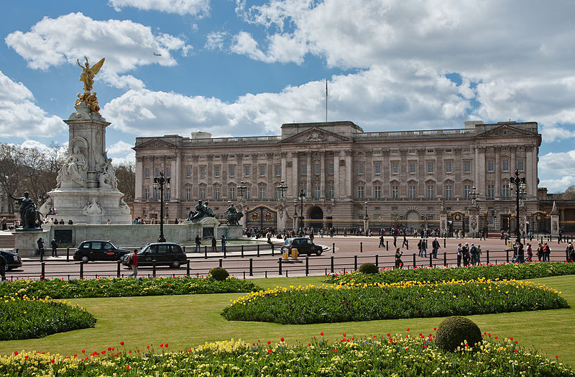
What is the official residence of the British monarch?

Slide 19
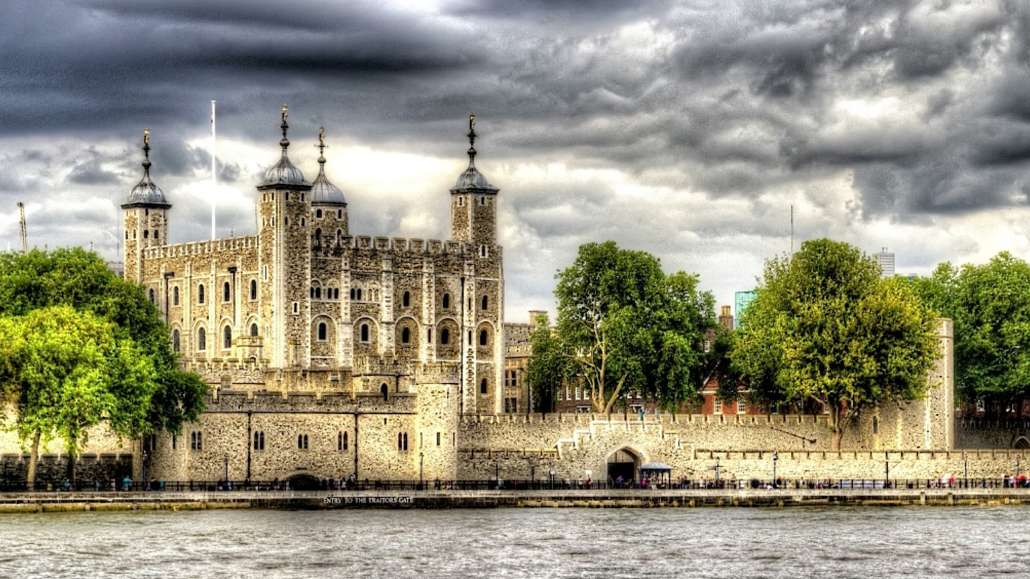
What is the Tower of London?

Slide 20
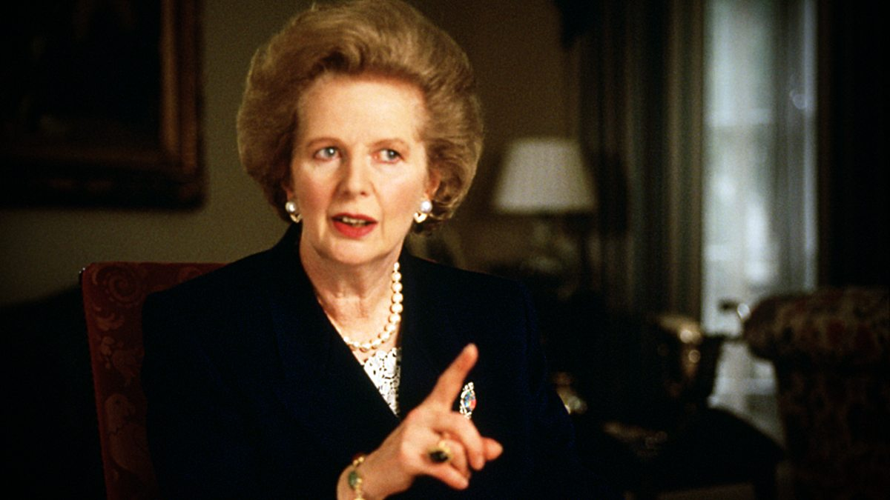
Who was called «an iron Lady»?

Slide 21
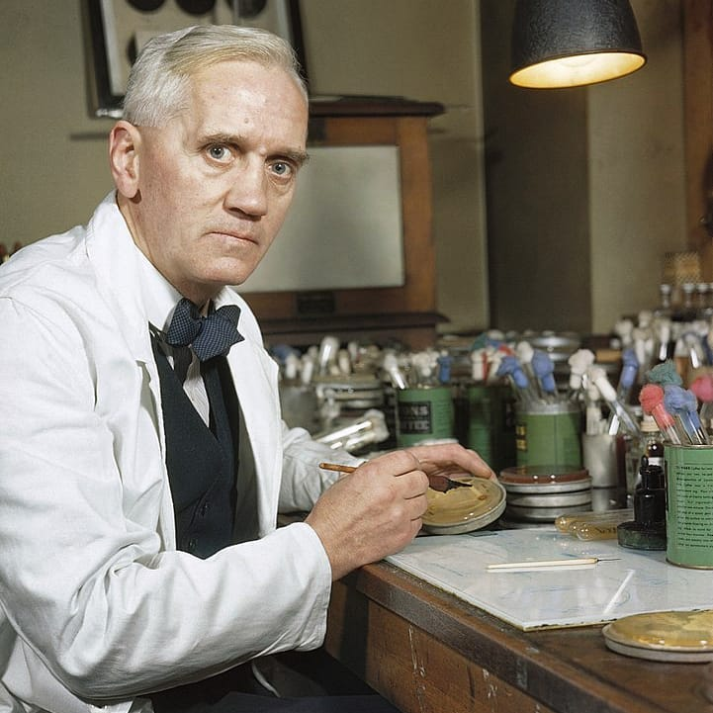
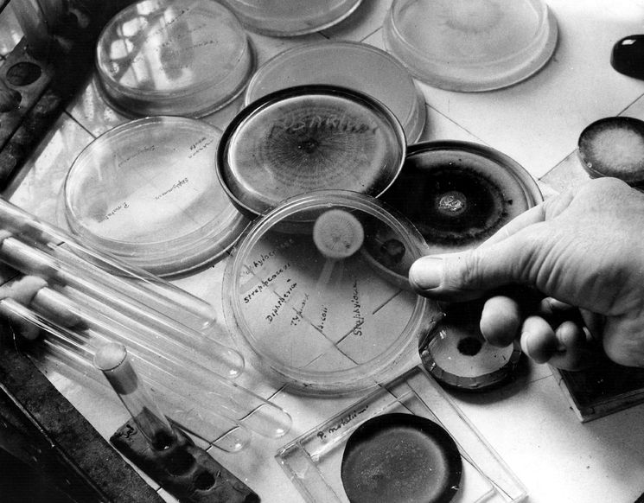
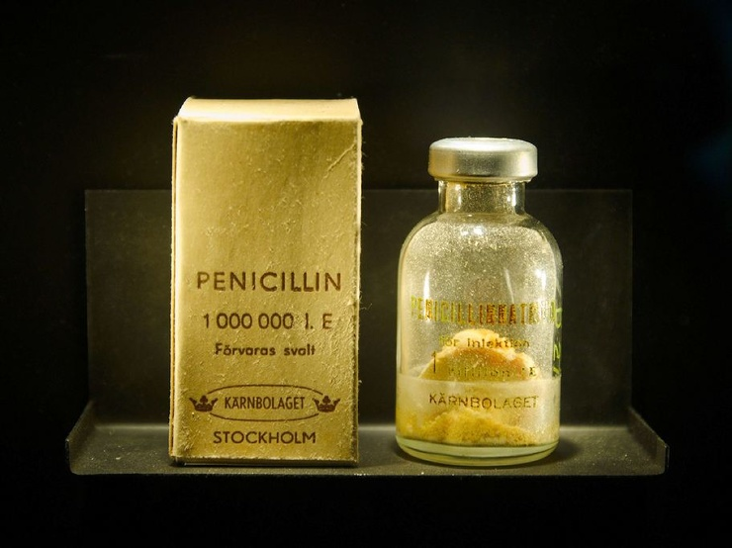
Who discovered penicillin?

Slide 22
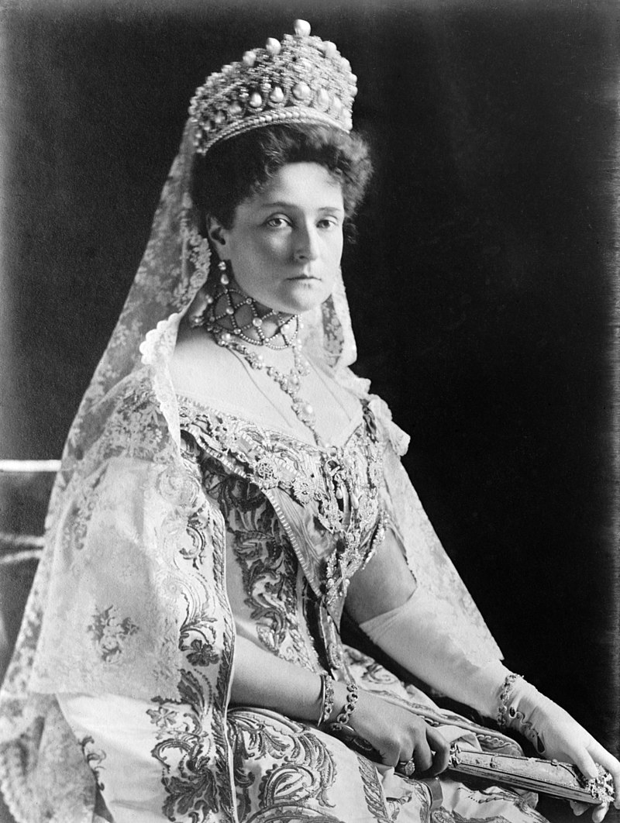
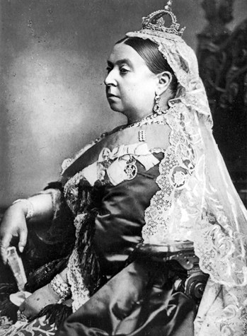
How was the last Russian Tsar’s family related to the British Royal Family?

Slide 23
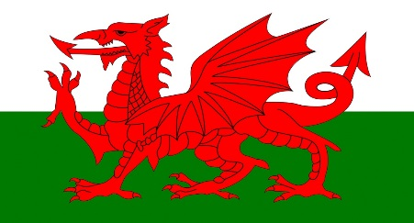
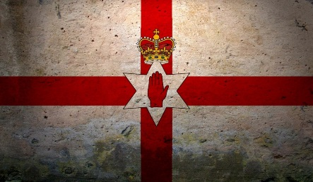
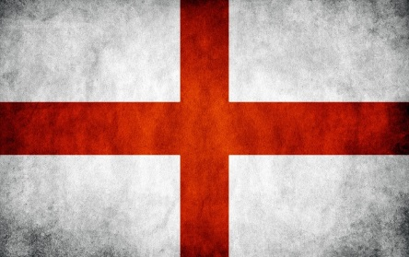

Slide 24
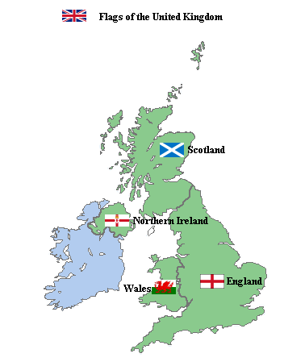
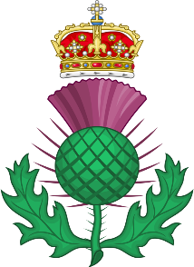
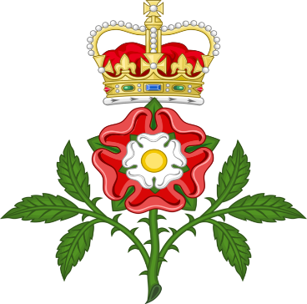
Edinburgh
Belfast
Cardiff
London

Slide 25
Great Britain
Geographical position
Politics of Great Britain
London
Famous British people

Slide 26
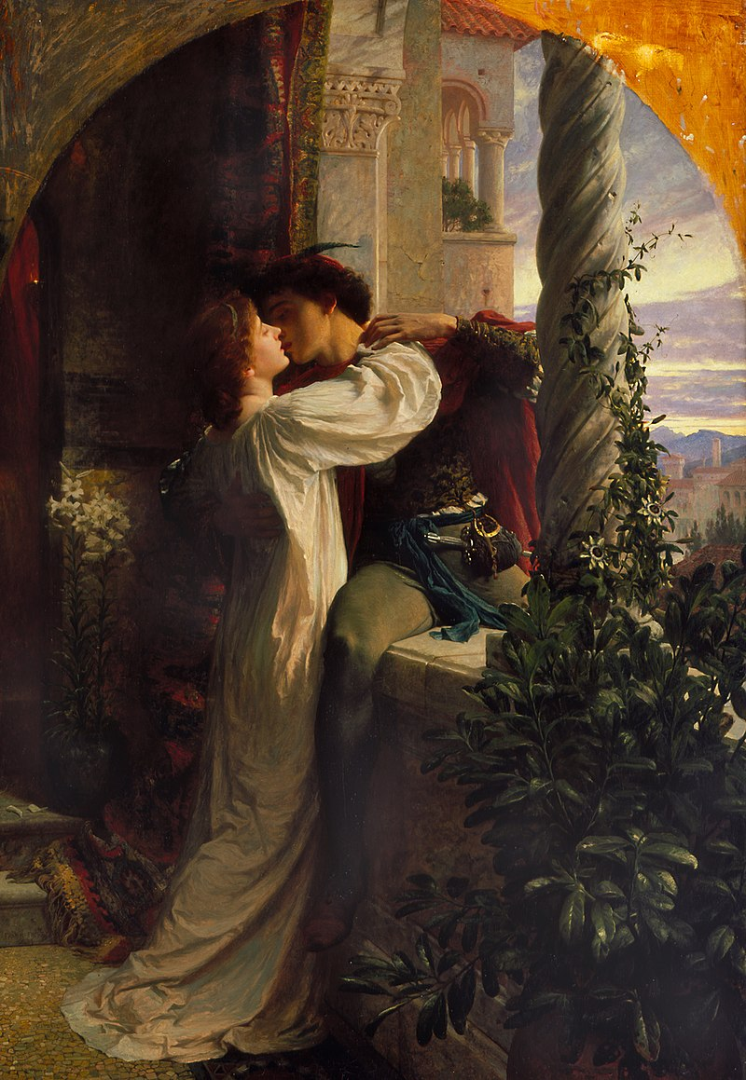
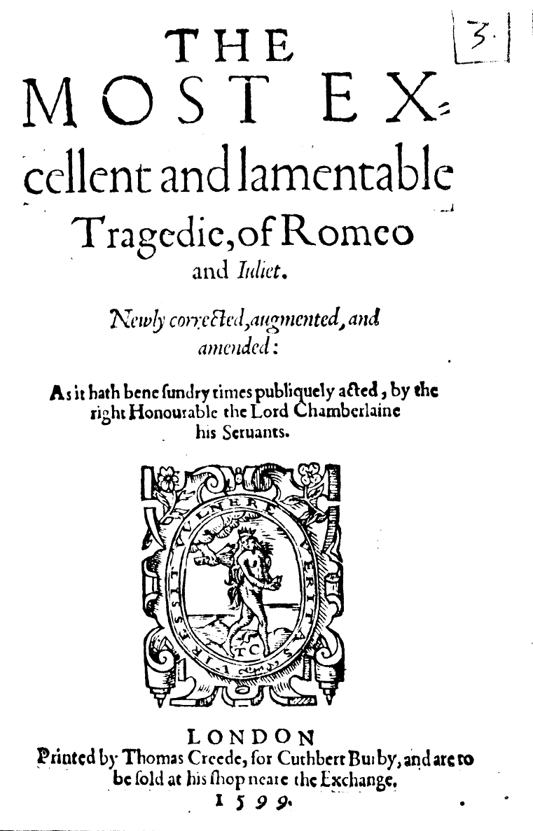
by Sir Francis Bernard Dicksee

Slide 27
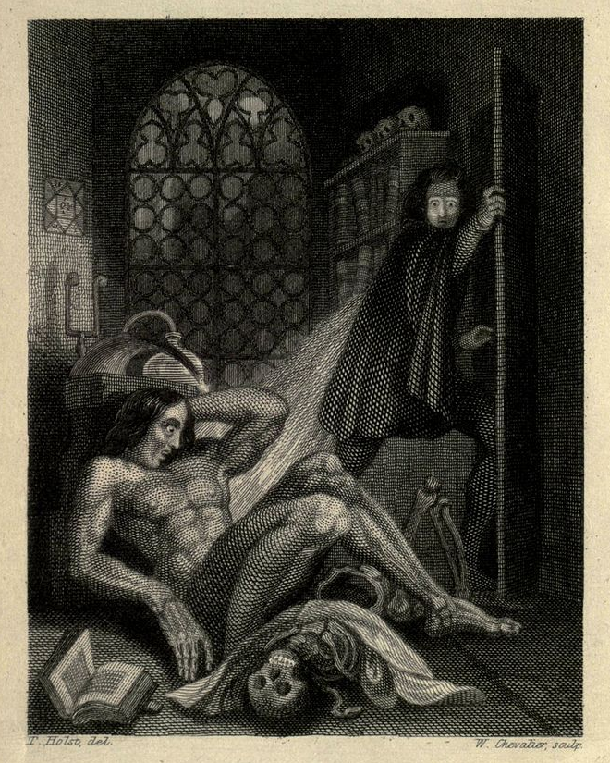
Richard Rothwell's
portrait
of Mary Shelley

Slide 28
Portrait of Daniel Defoe,
National Maritime Museum, London

Slide 29
Sir Arthur Ignatius Conan Doyle
by Sidney Paget, 1904

Slide 30
Sir Arthur Ignatius Conan Doyle
by Harry Rountree
in the novella The Poison Belt

